Slide 1



Ghidra vs Go
Carlton wilcox

Slide 2

What is ghidra
NSA developed, binary reverse engineering tool
Made open-source in 2019
Takes binaries and can “disassemble, assemble, decompile, graphing, and scripting along with hundreds of other features”
Still maintained by the NSA on their github….
Notes:
Ghidra breaks the code down to the assembly and allows you to mess around and break all of the good stuff in there.

Slide 3

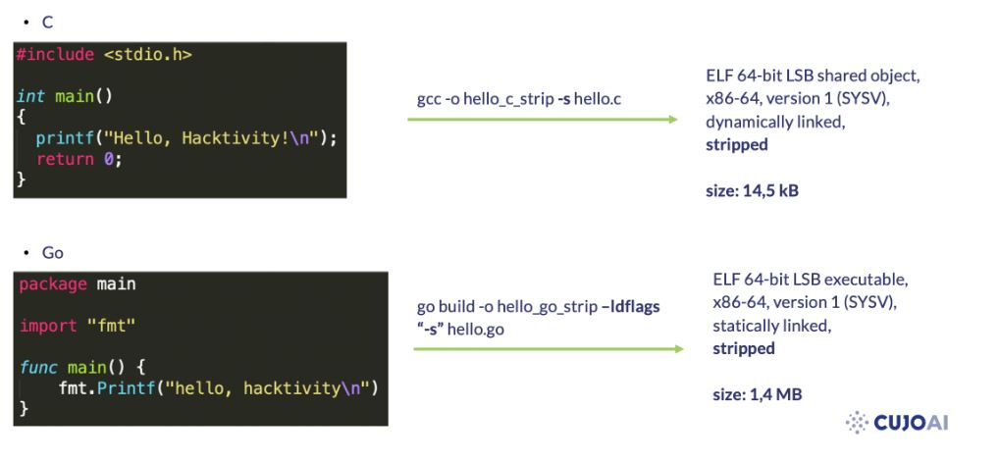

Project Source
CUJO AI
GO vs C
eCh0raix Ransomware (targeting QNAP network-attached storage (NAS) devices.)
Notes:
Ghidra breaks the code down to the assembly and allows you to mess around and break all of the good stuff in there.

Slide 4
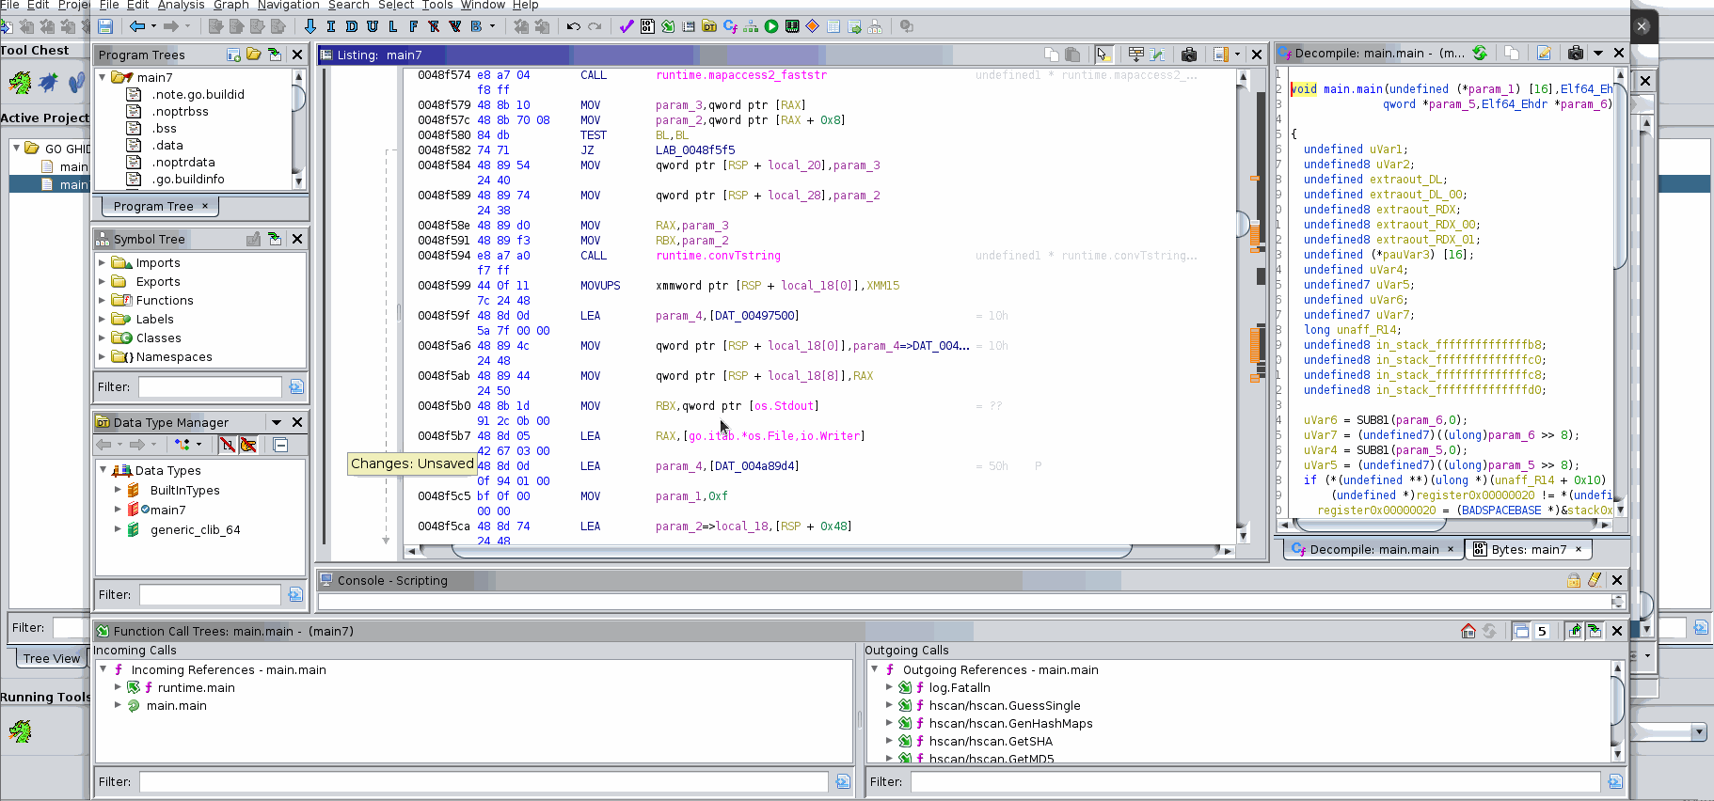
What is Reverse engineering
Break it apart and see how it works
Using the provided tools and information to manipulate the code
Assembly is hard.
Notes:
Ghidra breaks the code down to the assembly and allows you to mess around and break all of the good stuff in there.

Slide 5

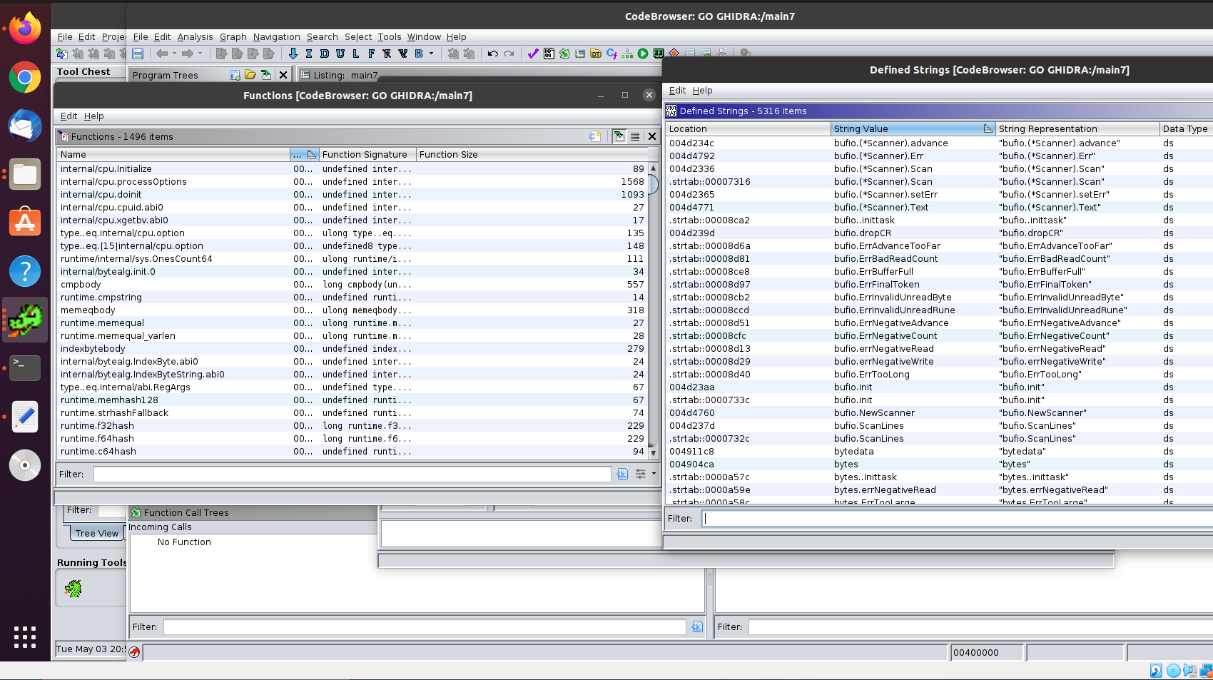
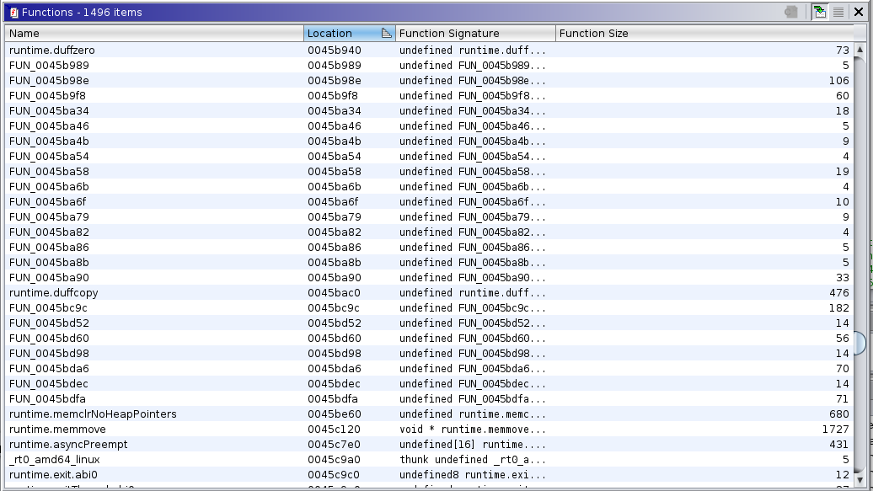
What did I do?
Installed Ghidra…. pain
Tried looking for familiar functions but found these
Notes:
Go binaries are compiled very differently and in stripped versions there are a lot more functions than are declared
Additionally, when trying to load go into Ghidra (which cant decmoplie go binaries without help) function names are lost. (show example)
So just like the article I found and executed the script they borrowed to recover the functions names which again allow for easier tracking

Slide 6
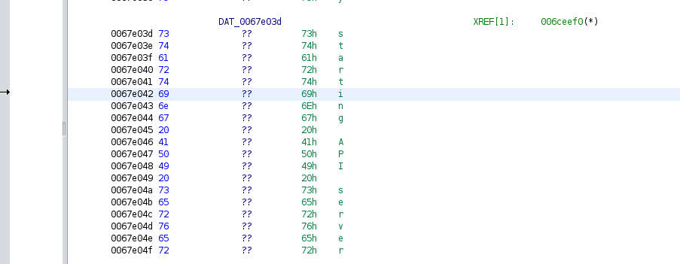
What did I do?
Ghidra struggles with stings because Go are a sequence of bytes instead of characters like in C.
So running their script which claims to solve the issue, I did find some strings that were identified and others that are not.
Looking for “Usage: ./main <target.txt>”

Slide 7
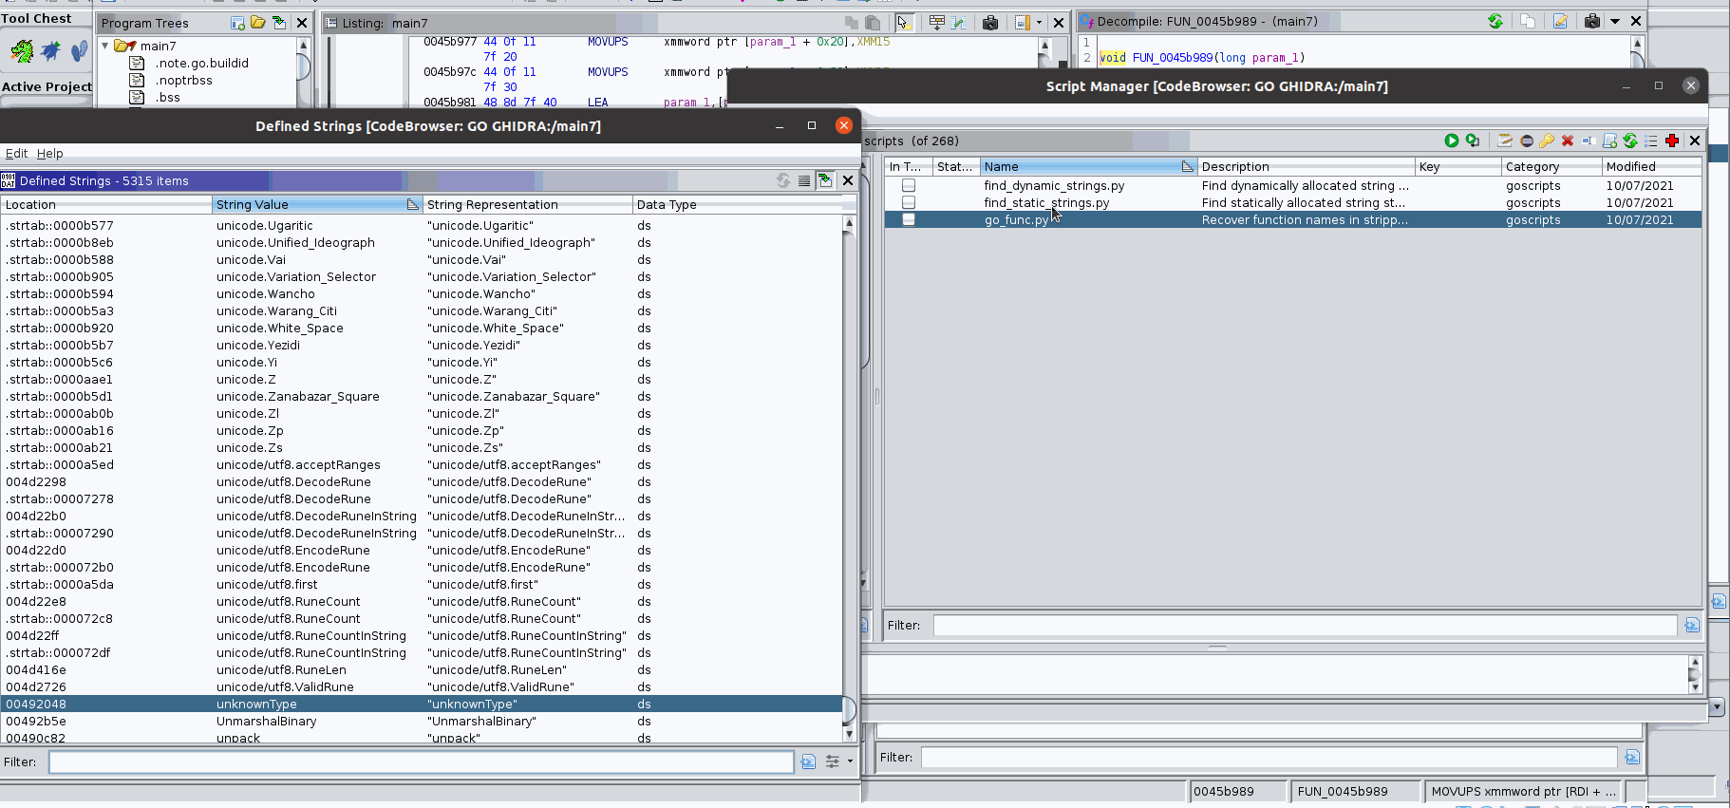
What did I do?

Slide 8
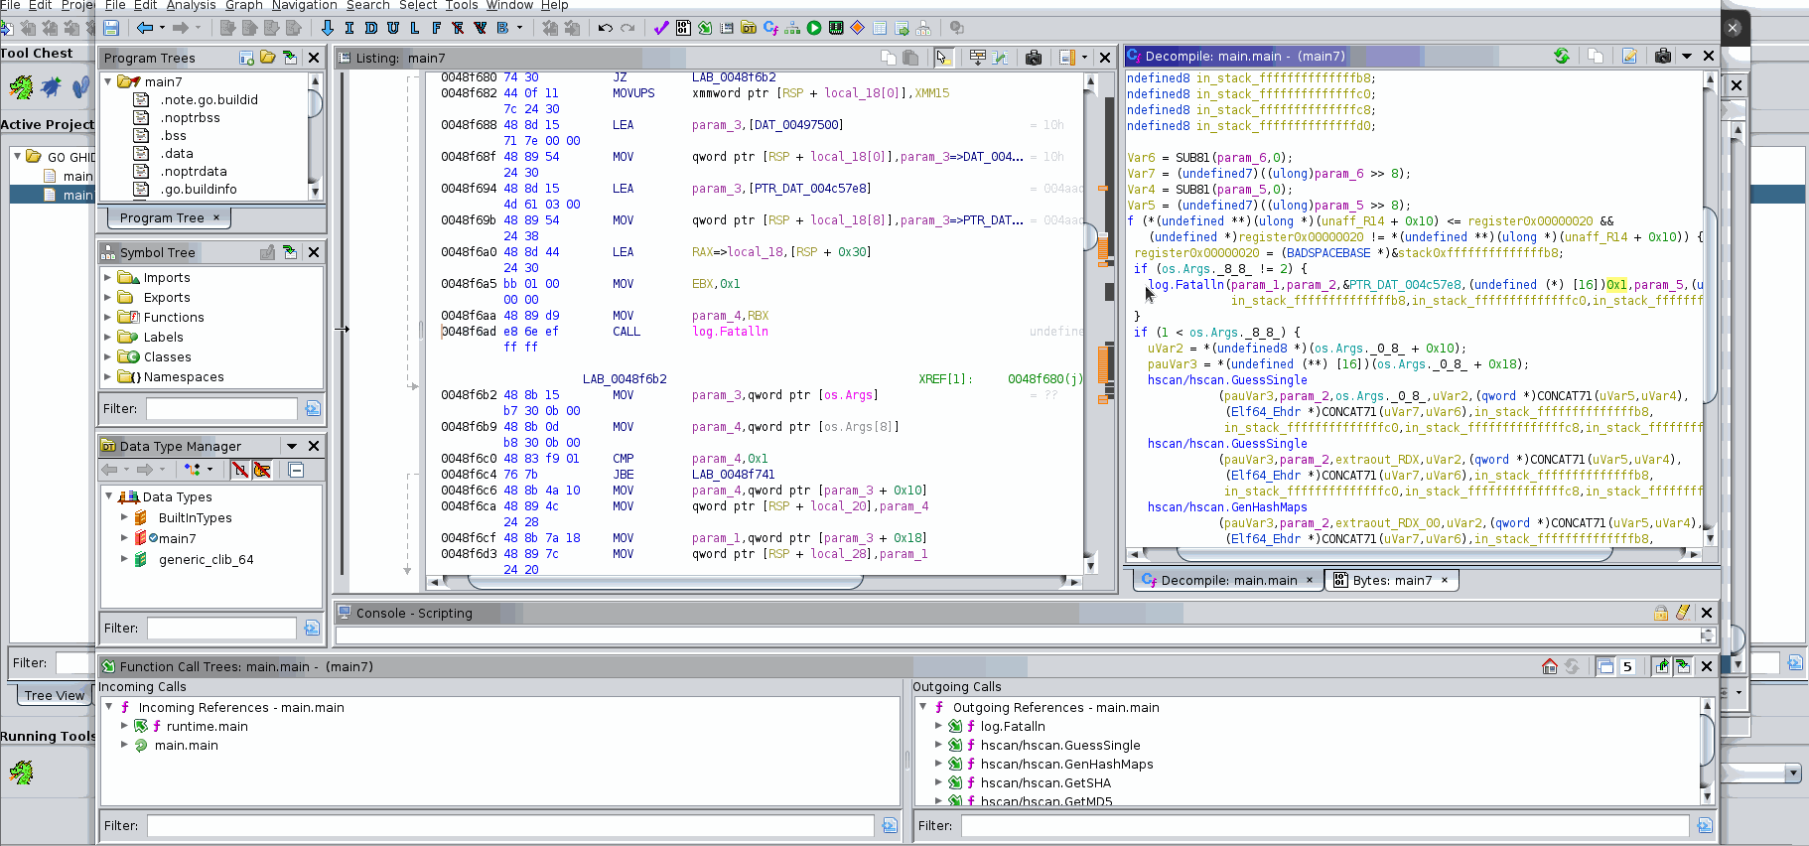
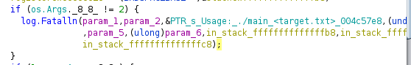
What did I do?

Slide 9
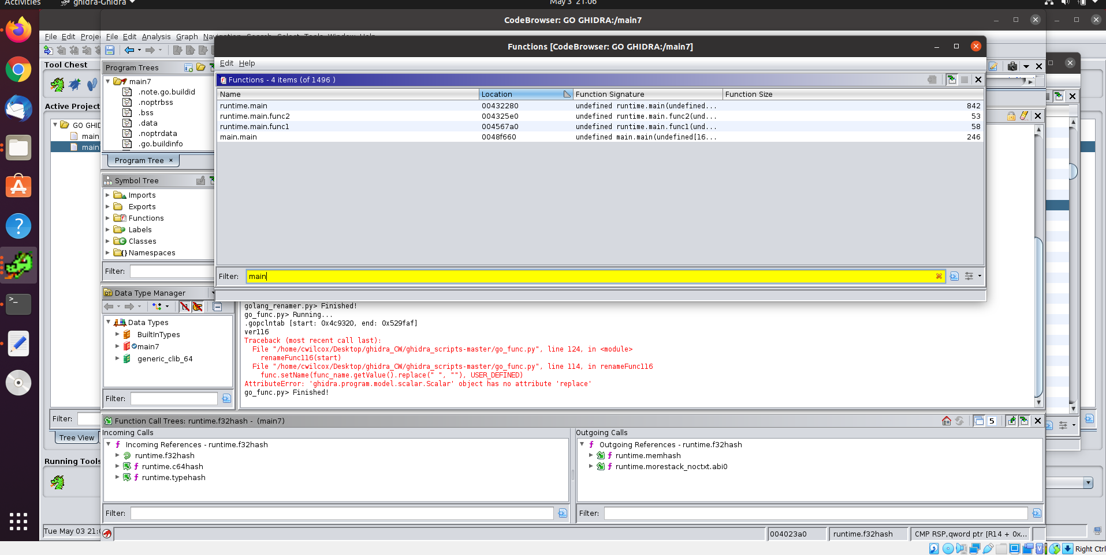
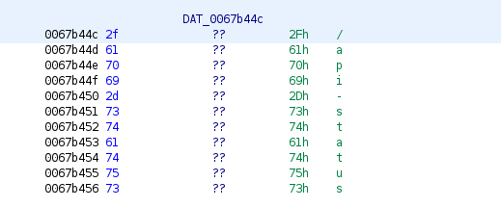
More struggles
Ghidra crashed…..
Some functions and strings were not found or allocated correctly
I tried to fix their scripts they wrote but just could not get
Notes:
Adding in their scriptcs caused key metadata files to get overwritten some how and tracking it down I think it was because of the function scripts.

Slide 10
Why was this important?
Go binaries are difficult to analyze
Go is a powerful tool
Other compilers similar results?

Slide 11
References
https://cujo.com/reverse-engineering-go-binaries-with-ghidra/
https://github.com/ghidraninja/ghidra_scripts/blob/master/golang_renamer.py
https://github.com/getCUJO/ThreatIntel/tree/master/Scripts/Ghidra
https://github.com/getCUJO/ThreatIntel/tree/master/Research_materials/Golang_reversing

